Slide 1
Software Controlled Drone
Presented By Kevin Libdan

Slide 2
Introduction
The software controlled drone will be controlled by an NRF24L01 transceiver which will send data to drone.

Slide 3
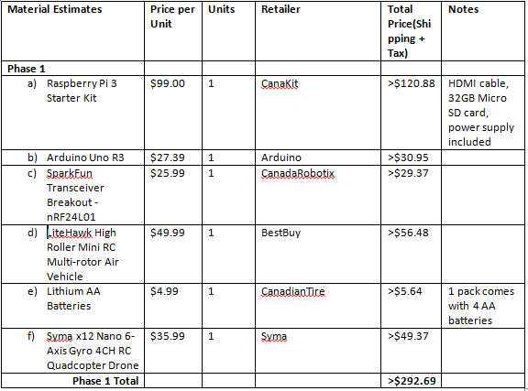
Updated Budget

Slide 4
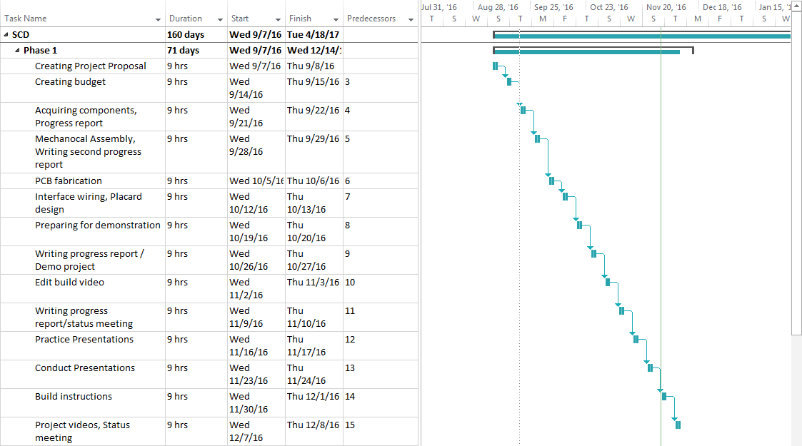
Project Schedule

Slide 5

Build Video

Slide 6
Knowledge Utilized From Previous Courses
CENG 215 – Digital and Interfacing Systems
TECH 153 – Technical C
CENG 216 – Introduction to Software Engineering

